Slide 1
Malignant Comments Classifier
Submitted By | Ankit Dadarwala | Data Science Intern at Flip Robo Technologies

Slide 2

Introduction
Problem Statement:
The proliferation of social media enables people to express their opinions widely online. However, at the same time, this has resulted in the emergence of conflict and hate, making online environments uninviting for users. Although researchers have found that hate is a problem across multiple platforms, there is a lack of models for online hate detection.
Online hate, described as abusive language, aggression, cyberbullying, hatefulness and many others has been identified as a major threat on online social media platforms. Social media platforms are the most prominent grounds for such toxic behaviour.

Slide 3
Introduction
Goal and Knowledge of Problem:
Internet comments are bastions of hatred and vitriol. While online anonymity has provided a new outlet for aggression and hate speech, machine learning can be used to fight it. The problem we sought to solve was the tagging of internet comments that are aggressive towards other users. This means that insults to third parties such as celebrities will be tagged as unoffensive, but “u are an idiot” is clearly offensive.
Our goal is to build a prototype of online hate and abuse comment classifier which can used to classify hate and offensive comments so that it can be controlled and restricted from spreading hatred and cyberbullying

Slide 4

Exercise
Build a model which can be used to predict in terms of a probability for each Mutli-label predict,.
In this case, target column has binary values so we used Classification based models.

Slide 5
Points to remember
There are no duplicates values in the dataset.
There are no null values in Dataset.
Data given by Fliprobo Technologies
Size of the dataset is 159571 rows and 8 columns with 6 target column
Data are text-data so we need to use NLP approached for ML

Slide 6
Project Goals
Analytical Problem Framing
Exploratory Data Analysis (EDA)
Visualizations
Data Pre-Processing
Model/s Development and Evaluation
Saving the best model and predicting the target
Conclusion and future work discussion

Slide 7
column Description
Malignant: It is the Label column, which includes values 0 and 1, denoting if the comment is malignant or not.
Highly Malignant: It denotes comments that are highly malignant and hurtful.
Rude: It denotes comments that are very rude and offensive.
Threat: It contains indication of the comments that are giving any threat to someone.
Abuse: It is for comments that are abusive in nature.
Loathe: It describes the comments which are hateful and loathing in nature.
ID: It includes unique Ids associated with each comment text given.
Comment text: This column contains the comments extracted from various social media platforms.

Slide 8
Exploratory Data Analysis
Data preprocessing
As a first step I have imported required libraries and I have imported the dataset which was provided in excel format.
Then I did all the analysis like checking shape, value counts, info, duplicates value null values etc.
I have also dropped “id”, column as I found they are useless.
While checking for null values I found null values in the dataset.
Make columns to check length of strings in particular comments.
Convert all text data into lower case.
Replace time date format to text format.
Replace all numerical no to text format.
Replace numeric IP address to text format.
Remove head and tail blank spaces.
Than make CLAENTEXT function to prepare text data, in that function remove string punctuation, tokenize comment in words, remove stop words like(I,me,u,your,have,had,etc…),than using POS TAG(part of speech) lemmatization the words.
Apply this function to comment_text column.
Again make column to check clean text length.
Using TFIDF Vectorize transform text to vectors and extract features for models
Shape : 159571 rows and 8 columns
No null values present
No Duplicate record found
Datatypes of text and int present

Slide 9
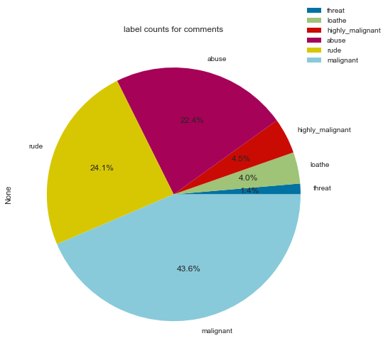
Label Distribution plot
Distribution of comment label are shown pie chart malignant are most

Slide 10
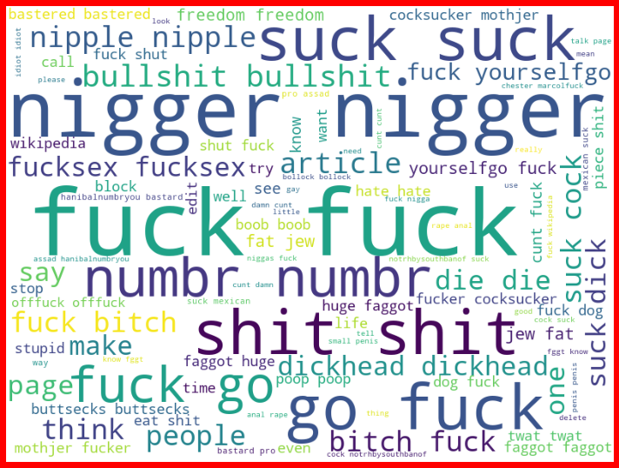
Word Cloud of Malignant comments
This is the word cloud for malignant comments.
As we can see, the content of the word cloud are pretty offensive and we can observe some racist words used in this

Slide 11
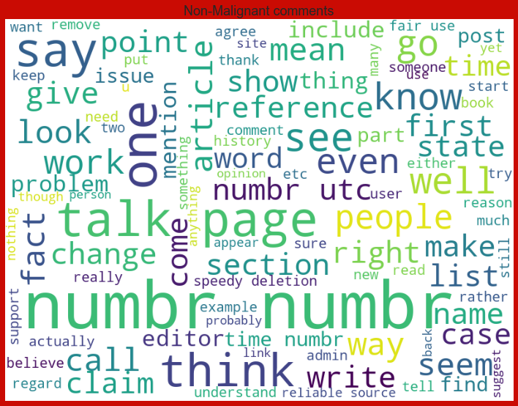
Word Cloud of Non Malignant comments

Slide 12
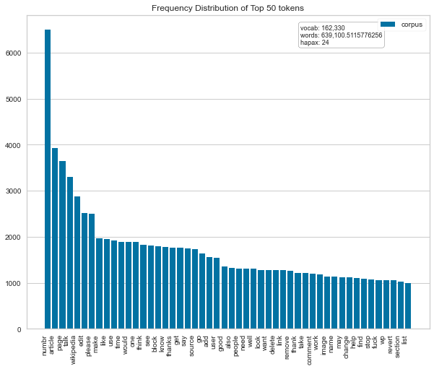
Frequency distribution of top 50 token words

Slide 13
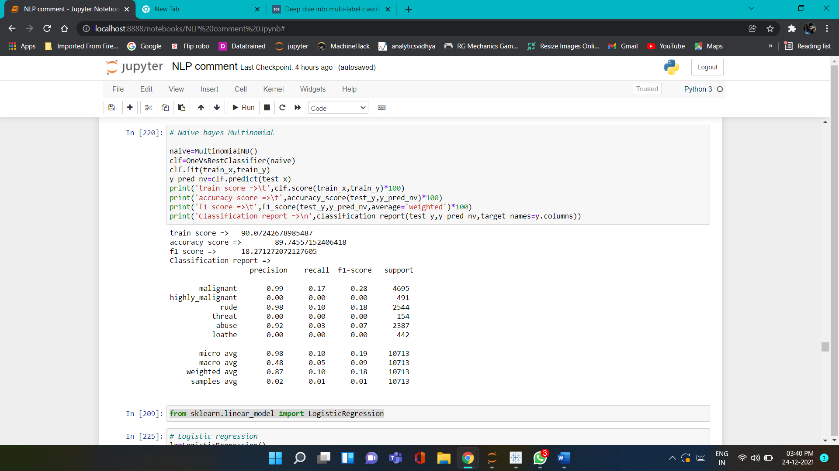
Run and evaluate select models
1). MultinomialNB:
Using Tf-idf vectorizer to extract features from clean text build different models base on that by using key metrics Accuracy score, F1 micro score,F1 weighted score, Hamming loss, Jaccard score base on that best model will selected

Slide 14
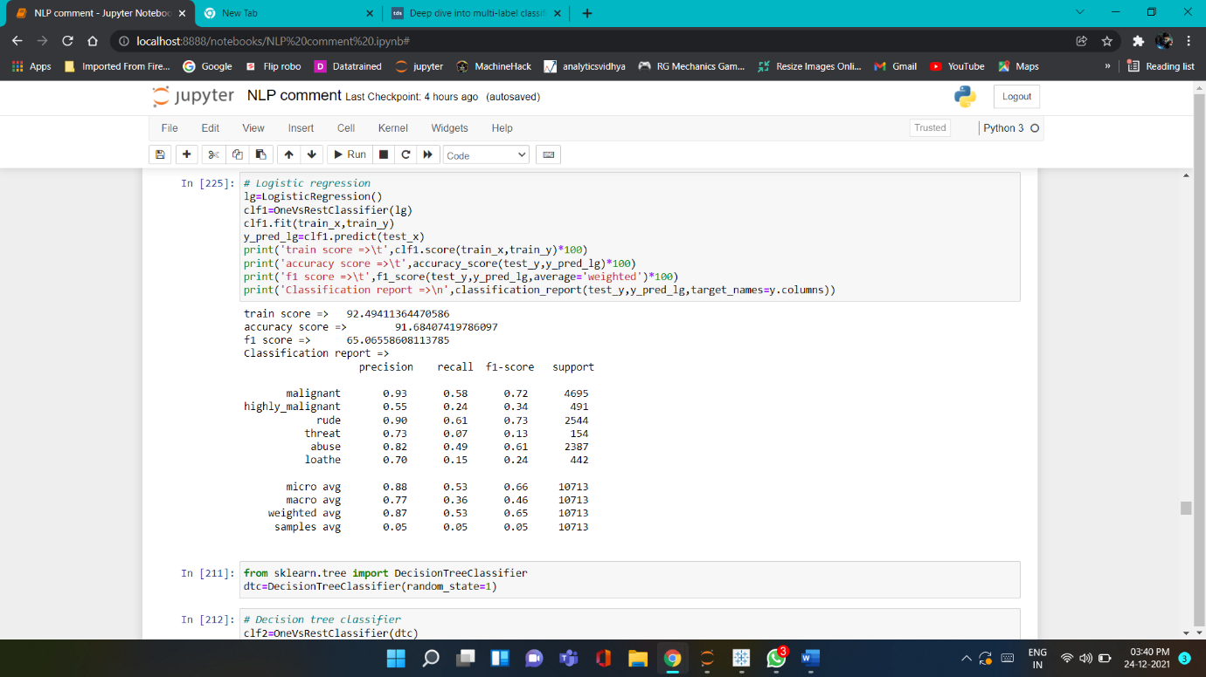
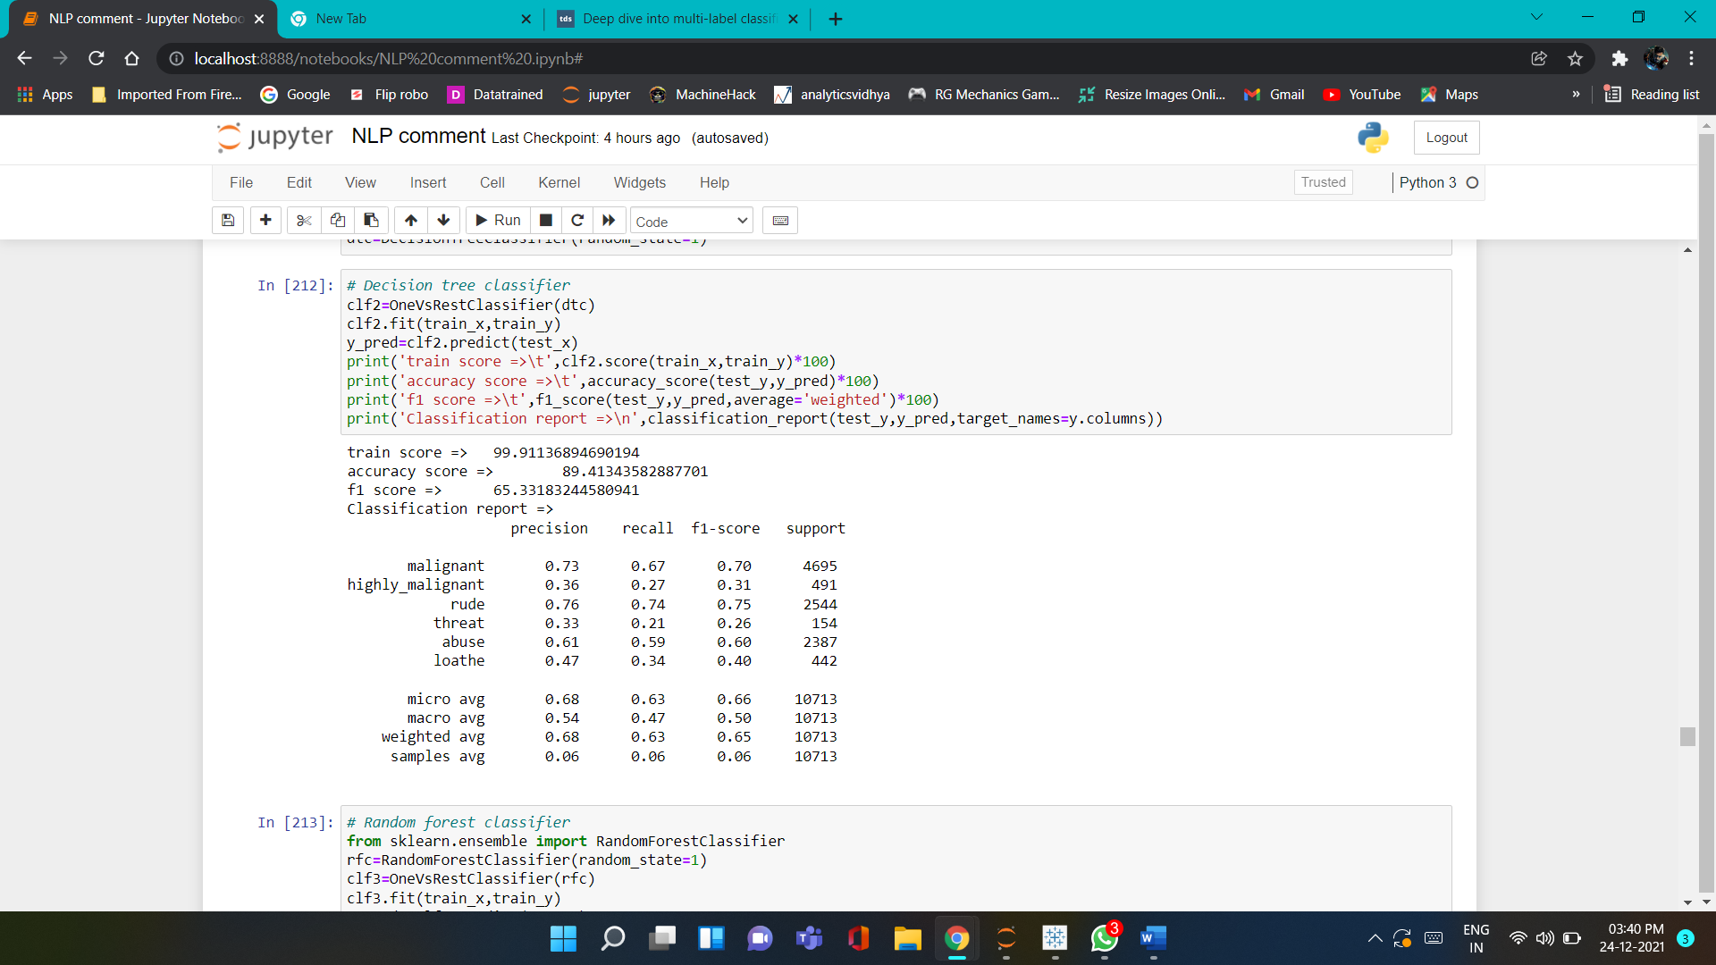
Run and evaluate select models
2). Logistic Regression
3). Decision Tree Classifier

Slide 15
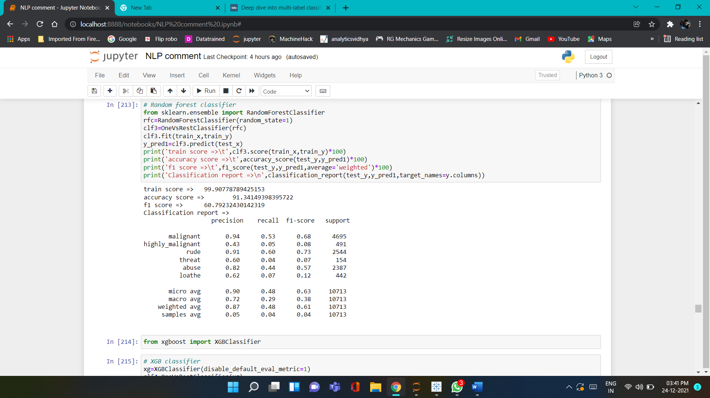
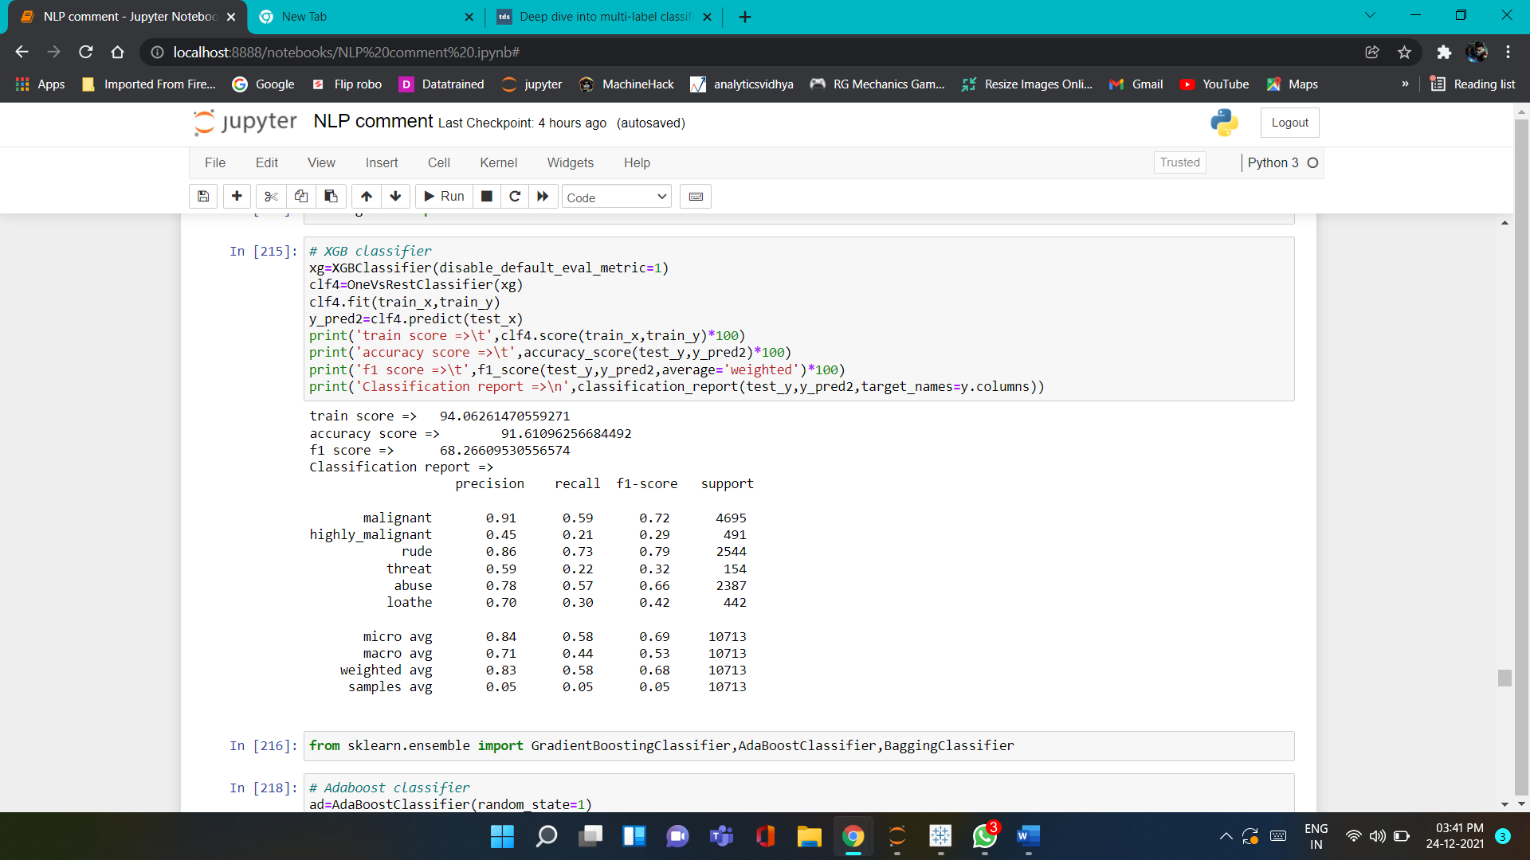
Run and evaluate select models
4). Random Forest Classifier
5). XGBoost Classifier

Slide 16
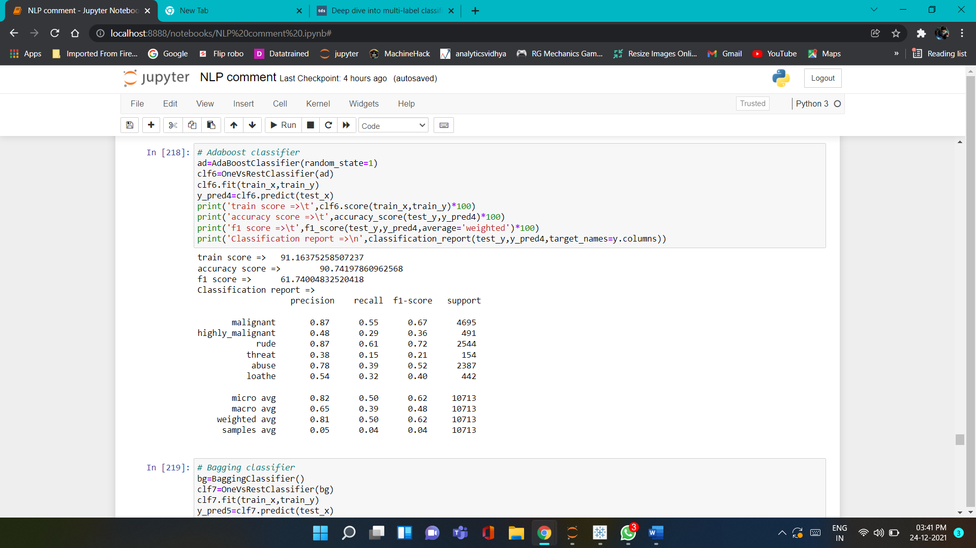
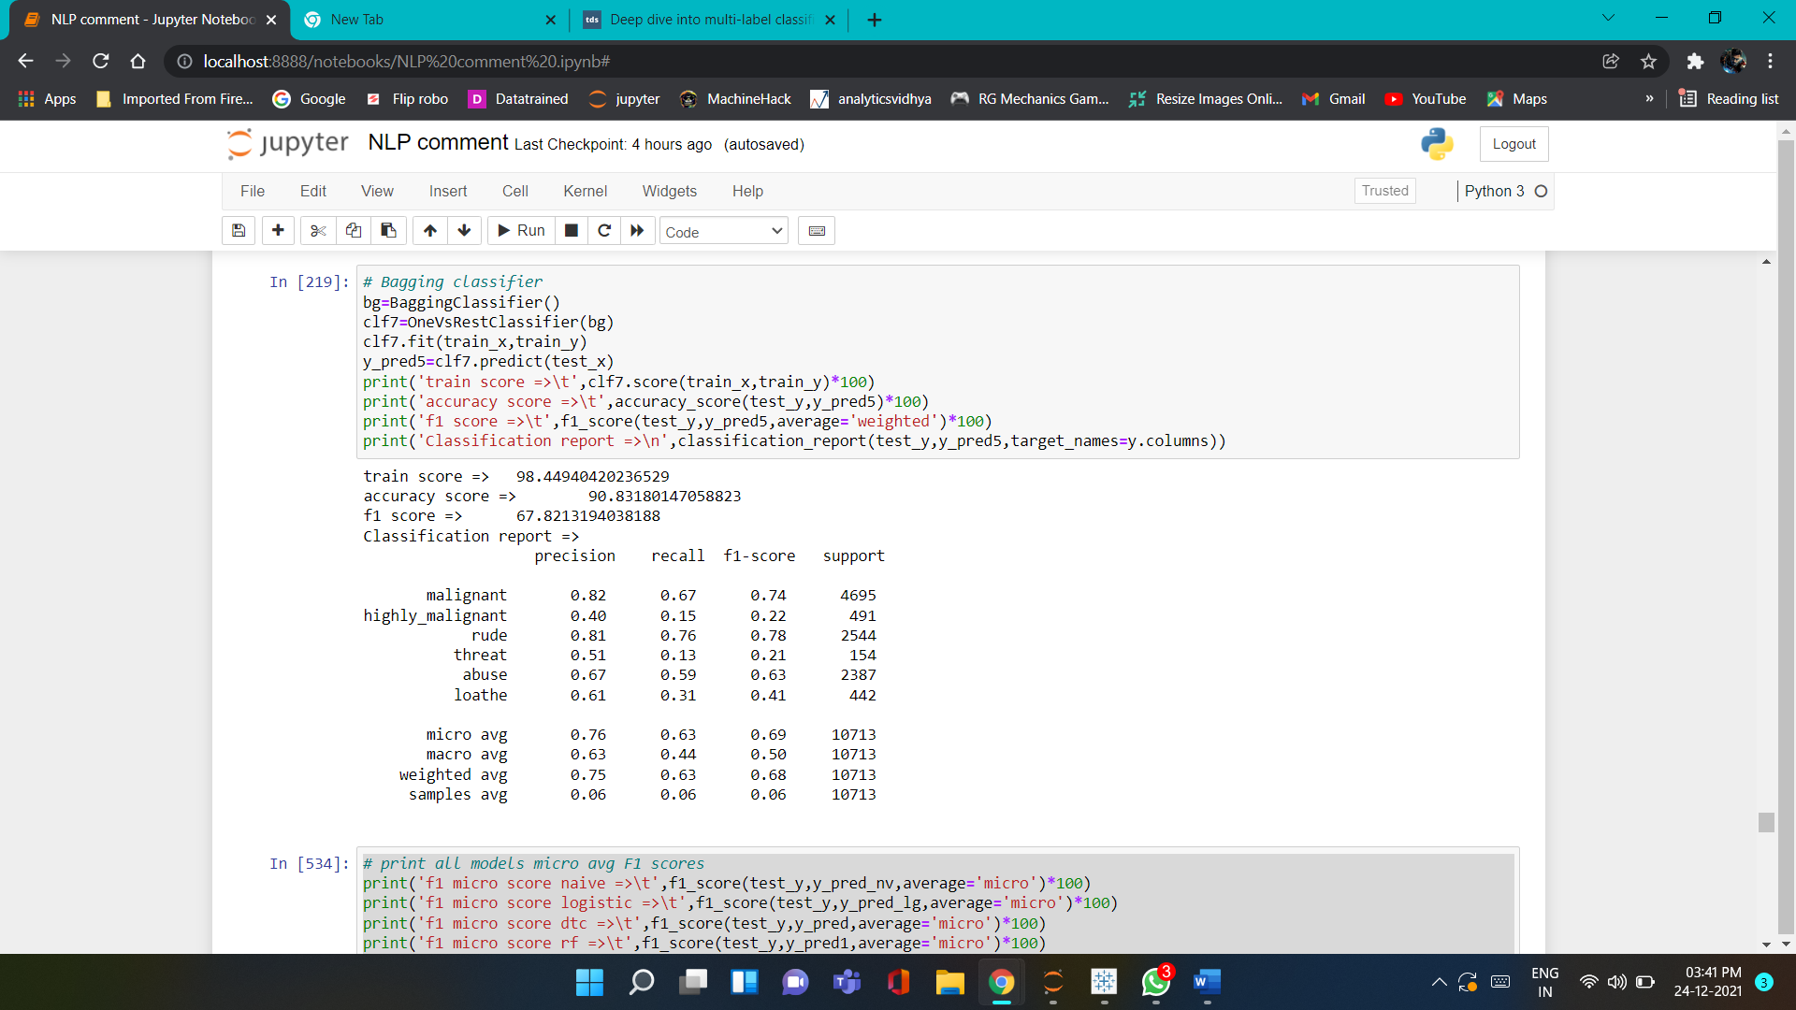
Run and evaluate select models
6). AdaBoost Classifier
7). Bagging Classifier

Slide 17
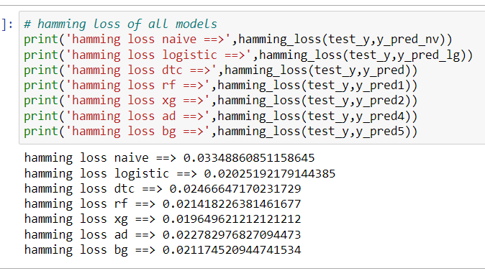
Evaluate select models
Hamming loss of all model
7). Jaccars score table
Sr.NO | Model name | Jaccard score
1 | MultinomialNB | 6.975
2 | Logistic Regression | 39.70
3 | Decision tree classifier | 38.62
4 | Random forest classifier | 36.02
5 | XGB Classifier | 41.69
6 | Ada boost classifier | 35.19
7 | Bagging Classifier | 42.62
From all Models XGBoost and Bagging both almost have same Accuracy score and F1-score but base on Jaccard score Bagging classifier works better.

Slide 18
Conclusion
Key Findings and Conclusions of the Study
In this project report, we have used machine learning algorithms to predict the multi-label class. We have mentioned the step-by-step procedure to analyse the dataset and feature extraction. These feature set were then given as an input to algorithms. Hence we calculated the performance of each model using different performance metrics and compared them based on these metrics. Then we have also saved the best model and predicted the label.

Slide 19
Limitations of this work and Scope for Future Work
The same problem can be solved using deep learning.
For more speed we could use decision trees and for a reasonable trade-off between speed and accuracy we could also opt for ensemble models.
In test data set some comments are in random symbols so we have encoding them into UTF-8 but not sure about their result predict by model.

Slide 20


